Slide 1
5014SGLH6-ES-L2-TR
异物分析報告
Foreign body analysis report
Prepared: Vic
Approved: Herry
Date: 2023/3/23

Slide 2
D1 Establish Team Approach
Team UP meeting (會議發起):
➔ When (時間) : 2023-3-18
➔ Where (地點) : 公司會議室
Champion (主要負責人員) :
Team Leader (FRB主席) : 宋小春—xiao chun Song
Team Member (成員)
生产(production)---刘平珍
品管(Quality control)---邹振元
設計(design)---罗禅
资材(material)---刘玉海
製工(fabricator)---李 強

Slide 3
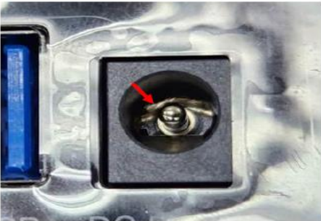
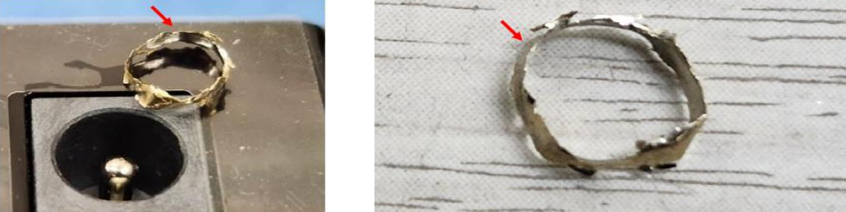
D2 Description Problem
1. Who：Foxconn(越南)
2. Which：5014SGLH6-ES-L2-TR
3. When：2023.3.18
4. Where：客戶端抽檢工站(Client sampling station)
5. What： Plug無法插到位,不良1PC；具體如下圖所示（The Plug can not be inserted in place, and the 1PC is not good. The details are shown in the following figure）：

Slide 4
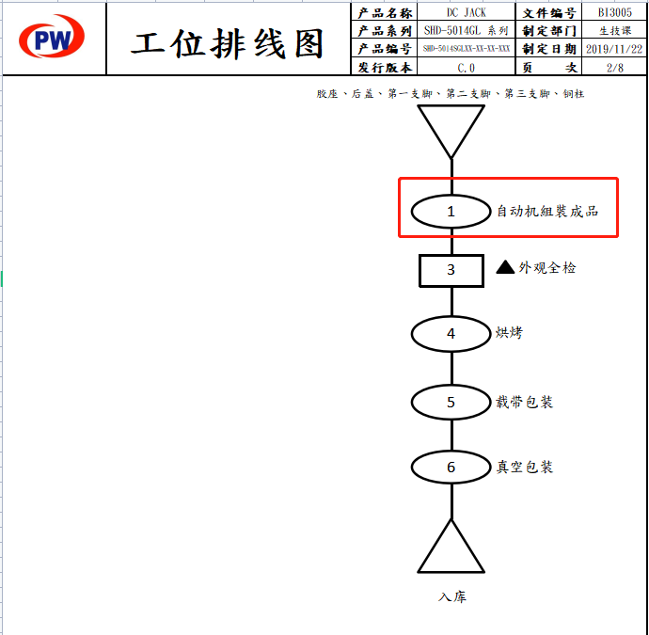
D3 Root Cause & Findings
3.1 工艺图排查，风险工站确认
3.1 Process drawing check and risk station confirmation
经对制程组装过程进行确认，可确定此为风险工站
After confirming the assembly process of the manufacturing process, it can be determined that this is a risk station

Slide 5
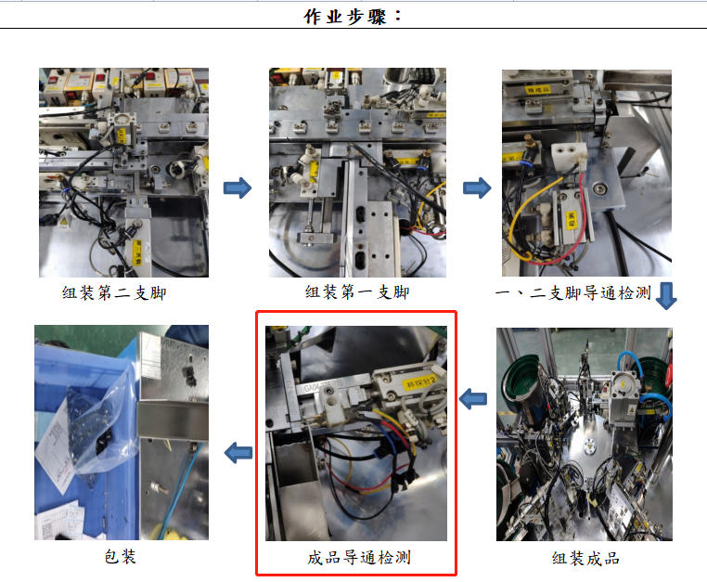
D3 Root Cause & Findings
3.2 异物产生工站确认
3.2 Confirmation of foreign body production station
对组装过程确认，可确定此为异物产生工站
To confirm the assembly process, it can be determined that this is the foreign body generating station

Slide 6
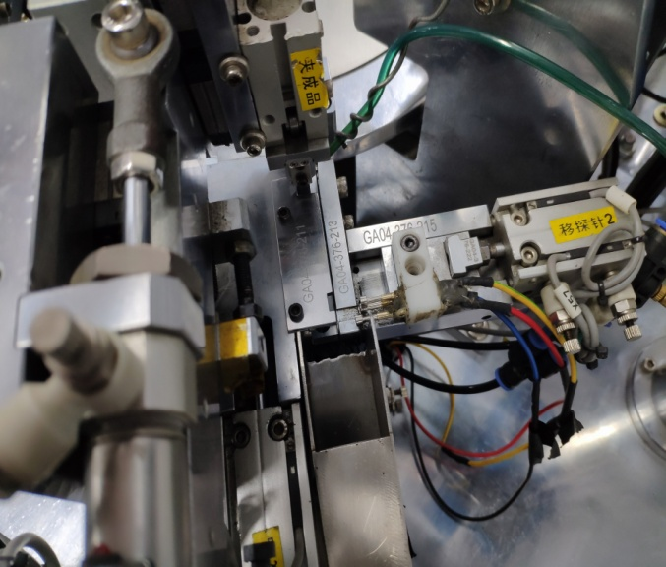
D3 Root Cause & Findings
3.3 异物产生真因确认
3.3 Confirmation of the true cause of foreign bodies
功能测试探头
Functional test probe
确认为测试探头铜环
Confirm as test probe copper ring
小结；
summary;
1、经过确认公头内圆环为测试机台的探头铜环，测试探头长时间测试使用，出现损伤。
1. After confirming that the inner ring of the male head is the probe copper ring of the testing machine, the test probe has been tested for a long time, resulting in damage.
2、经过确认生技保养记录，此测试探头使用次数达到6万次，经长时间使用，导致磨损/损伤，测试时探头铜环脱落留在DC内。
2. After confirming the production technology maintenance record, the test probe has been used for 60,000 times, which leads to wear/damage after a long time of use. During the test, the probe copper ring falls off and stays in DC.

Slide 7
D4 Corrective Action
4.1 增加测试探头的使用寿命管控（调整为5万次），以此防止测试探头使用次数过多，导致铜环脱落。
4.1 Increase the service life control of the test probe (adjust to 50,000 times) to prevent the copper ring from falling off due to excessive use of the test probe.
---責 任 人（Responsible person）：李強
---完成時間（Completion time）：2023/03/23
4.2 将此不良异常，制作为“不良看板”，进行内部宣导，并悬挂于生产现场警惕作业人员，随时检查测试探头的磨损/损伤情况。
4.2 Make the bad anomaly as "bad Kanban" for internal promotion, and hang it on the production site to alert operators and check the wear/damage of the test probe at any time.
---責 任 人（Responsible person）：Arvin
---完成時間（Completion time）：2023/03/20

